Slide 1

Machine Learning Introduction
AWS Sagemaker Canvas Tutorial

Slide 2
Machine Learning is a general name given to an extensive collection of algorithms that are used to allow a computer to identify patterns in past data and use those patterns to predict future results. The field of Machine Learning is considered to be a subset of a field called Artificial Intelligence. Often, the terms concatenated together as AI/ML.
AWS Sagemaker Canvas Tutorial

Slide 3
Recommendation systems on your favorite streaming services like Netflix or Spotify are run by machine learning. Search engines use machine learning to clarify and optimize your search results. Social media channels recommend friends, groups and videos to watch. If you have a modern fridge, often these learn when you use it the most and cool it in anticipation of dinner time. GPS anticipates what parts of your route will have heavy traffic and re-routes you using machine learning algorithms. Voice-based assistants like Alexa and Siri use machine learning to operate.
AWS Sagemaker Canvas Tutorial

Slide 4
ML is used by : Google Amazon Oracle Red Hat Netflix Microsoft IBM …and almost every big or small organization !
AWS Sagemaker Canvas Tutorial

Slide 5
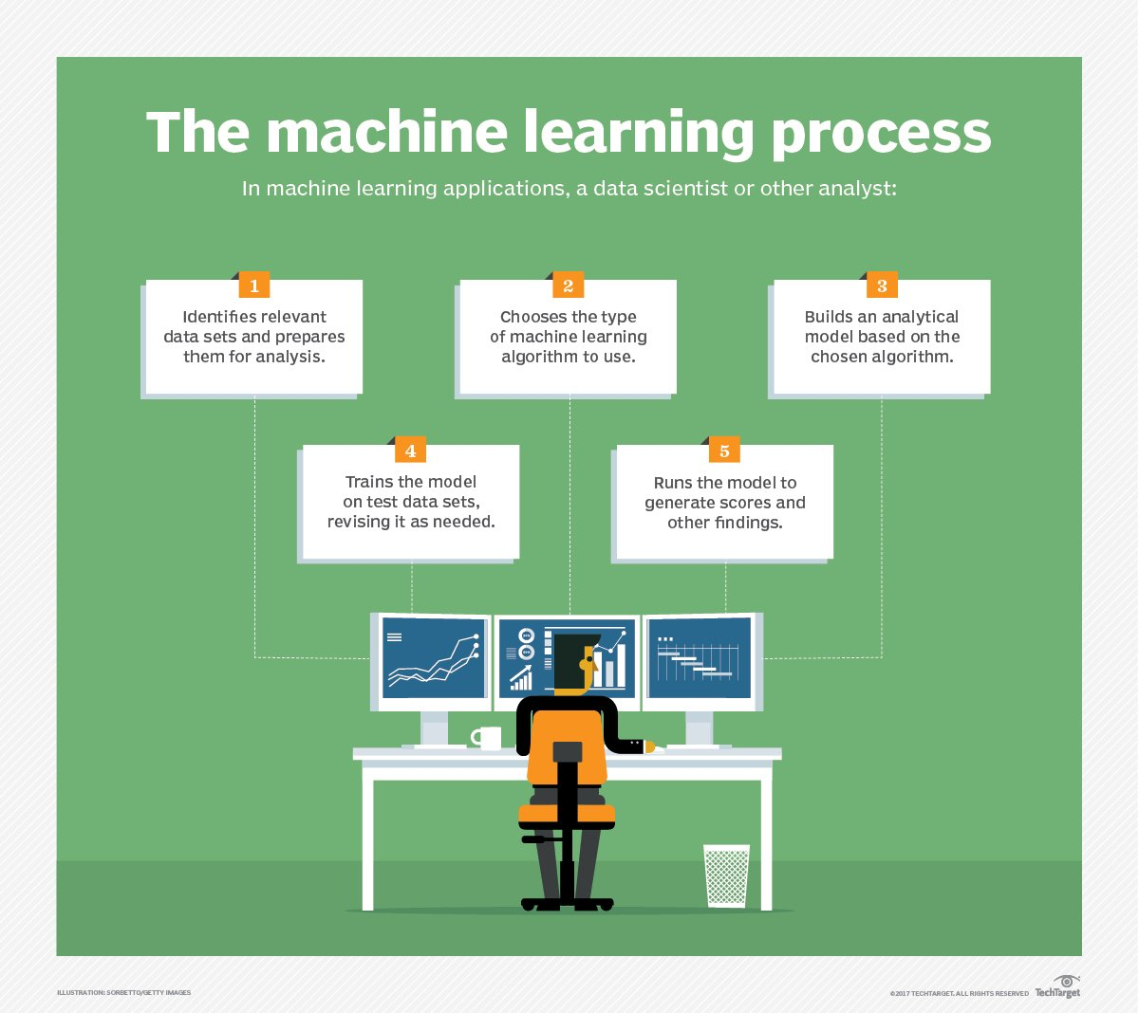
AWS Sagemaker Canvas Tutorial

Slide 6
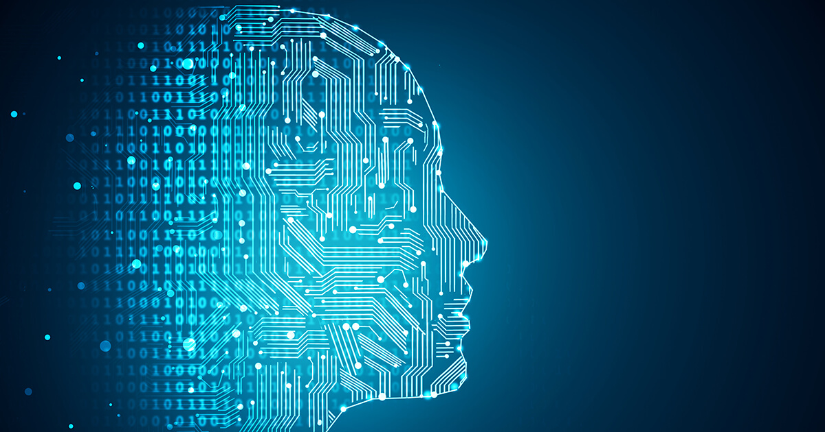
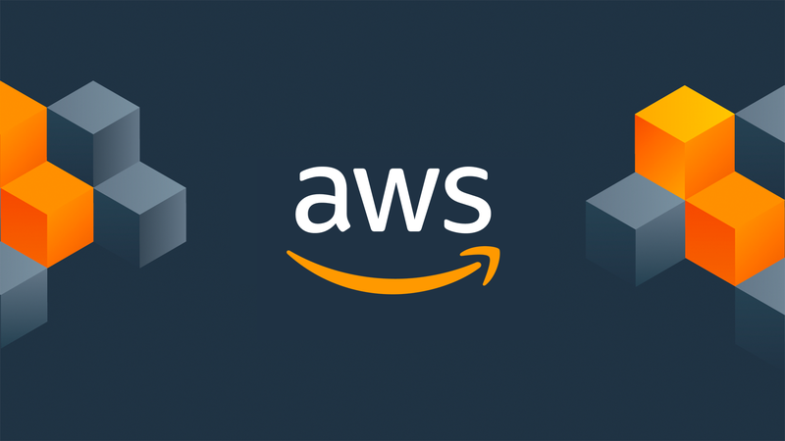


Amazon SageMaker Canvas
CONGRATULATIONS on completing the course !!
Prince Patni

Slide 7


